Slide 1
For Live Session
Unit 12

Slide 2
Activity Two: Create Your Own GitHub Page
First Step:
Simply create your own website using your personal GitHub account.
Completed:
ReuvenDerner.github.io
https://reuvenderner.github.io/

Slide 3
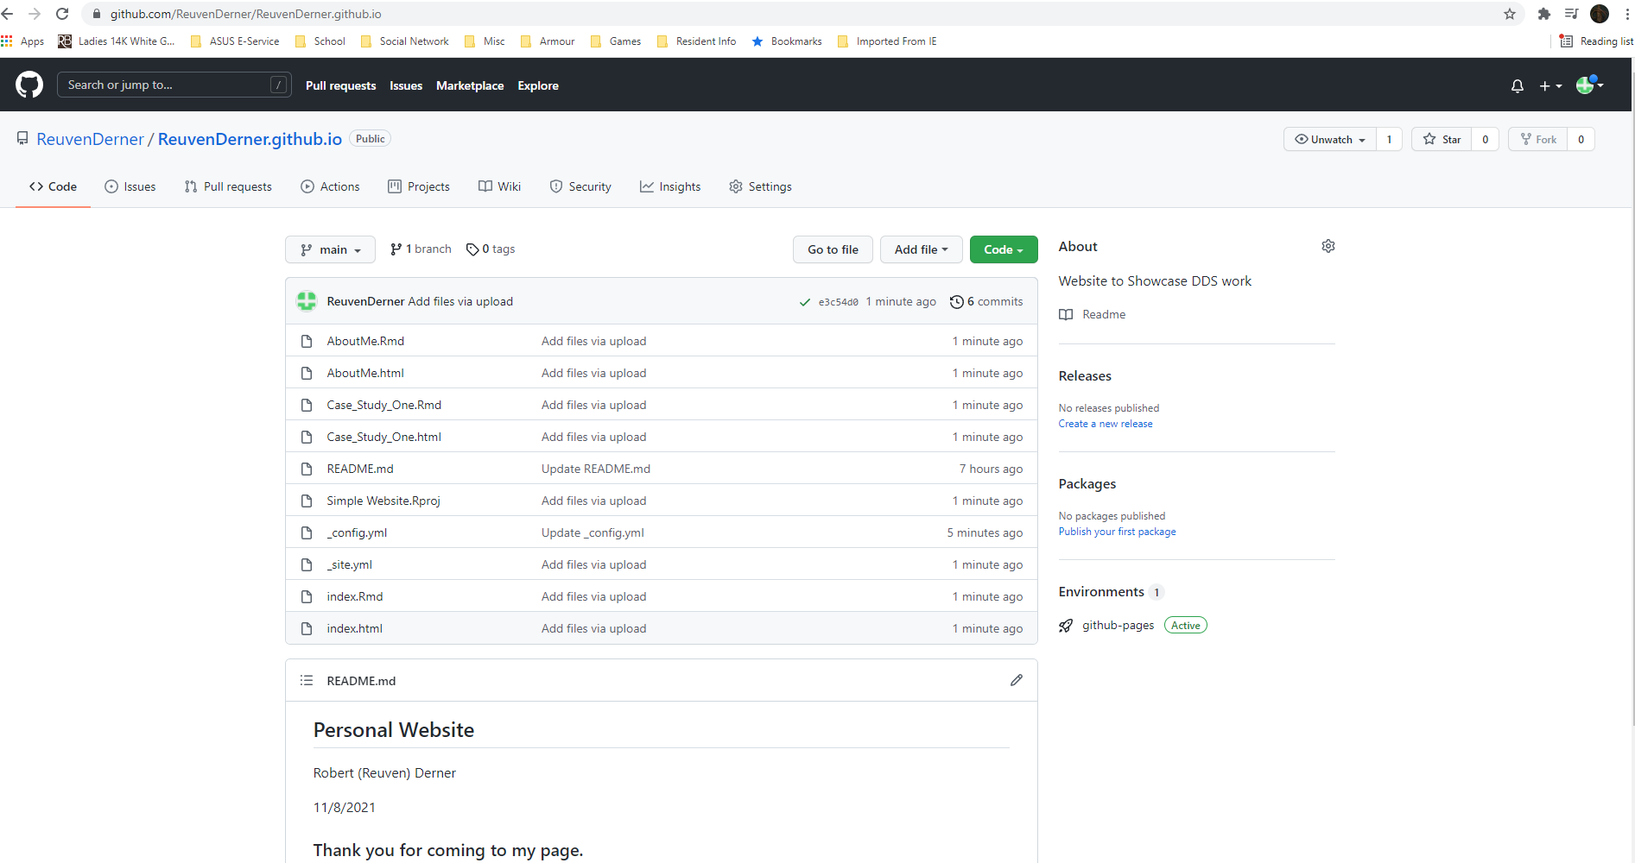
Activity Three: Create a Welcome Tab
After 7 hours trying to create this I’m done…..below is a screenshot of the files uploaded to git, however they are not updating on the actual website created

Slide 4
Activity Four: Create a Case Study 1 Tab (See previous)
_site.yml:
name: "my-website"
navbar:
title: "My Website"
left:
- text: "Home"
href: index.html
- text: "About Me"
href: AboutMe.html
- text: "Case Study One"
href: Case_Study_One.html
Case_Study_One.Rmd Case_Study_One.html

Slide 5
Activity Five: Create an Rshiny App (8 hours)
Create a Rshiny app that will do the following
Let the user read in the data (the Beer Data.)
Let the user make a histogram of the IBU
Let the user make a histogram of the ABV (separate histogram)
Low the user switch back and forth between histograms and boxplots to represent this information. You could do this with a radio button that switches the plot from histogram to boxplot … the implementation however is up to you.
Allow the user to filter the histograms / boxplots above by state.
In addition to the histograms, add a scatter plot of IBU v. ABV
Add the ability to add or take off the simple linear regression line.
Allow the user to filter the data on the scatter plot by state.
Add at least one additional plot from your analysis and make sure to clearly label and/or describe the information it is conveying.
Add the link to the tab you created for Case Study 1.

Slide 6
Activity Six: Create an Rshiny App (The Histogram, Boxplot, & Linear Regression Display, filter doesn’t work)
---
title: "testShiny"
author: "Reuven"
date: "11/9/2021"
output: html_document
---
```{r setup, include=FALSE}
knitr::opts_chunk$set(echo = TRUE)
```
## Rshiny Test
This is a test of an RShiny app in RMarkdown
```{r }
library(shiny)
library(ggplot2)
library(ggsn)
library(usmap)
library(dplyr)
library(tidyverse)
#Read in Data Set
beers = read_csv(url("https://raw.githubusercontent.com/BivinSadler/MSDS_6306_Doing-Data-Science/Master/Unit%208%20and%209%20Case%20Study%201/Beers.csv"))
breweries = read_csv(url("https://raw.githubusercontent.com/BivinSadler/MSDS_6306_Doing-Data-Science/Master/Unit%208%20and%209%20Case%20Study%201/Breweries.csv"))
full_data = merge(beers,breweries,by.y="Brew_ID",by.x="Brewery_id") %>%
mutate(fips = fips(trimws(State)))
Aledata = full_data %>% mutate(IPA = grepl('IPA',full_data$Style), Ale = grepl('Ale',full_data$Style)) %>% filter(IPA | Ale) %>% select(Ale,IPA,ABV,IBU, Style)
Aledata = Aledata %>% mutate(Alcohol_by_Volume = scale(ABV),biterness_scale = scale(IBU)) #Get Ranges of ABV and IBU data
# Define UI for random distribution app ----
ui <- fluidPage(
selectInput("Ind","Indipendent Variable",choices = names(full_data)),
selectInput('Dep','Dependent Variable',choices = names(full_data)),
selectInput("State","State Variable",choices = unique(full_data$State), selected = "CA"),
plotOutput("BoxPlot"),
plotOutput('Hist'),
plotOutput("Scatter"),
plotOutput("Ale")
)
server <- function(input, output, session) {
data1 <- reactive({
input$Ind
})
data2 <- reactive({
input$Dep
})
state <- reactive({
input$State
})
output$BoxPlot <- renderPlot({
boxplot(get(data2()) ~ get(data1()) , data=full_data)
#attempt at filtering dataset and utilizing select cause application to break: full_data %>% filter(State == input$v_select) %>%
})
output$Hist <- renderPlot({
req(data1())
hist(full_data[[data1()]])
#attempt at filtering dataset and utilizing select cause application to break: full_data %>% filter(State == input$v_select) %>%
})
output$Scatter <- renderPlot({
full_data %>%
ggplot(aes(x = ABV, y = IBU, fill = "sample")) +
geom_point() + geom_smooth(method = lm) +
ggtitle("Relationship Between IBU and ABV")
#attempt at filtering dataset and utilizing select cause application to break: full_data %>% filter(State == input$v_select) %>%
})
output$Ale <- renderPlot({
Aledata %>% ggplot(mapping = aes(x=Alcohol_by_Volume,y=biterness_scale,color=Ale)) + geom_point(position = 'jitter') +
scale_color_manual(values=c("chartreuse4", "deepskyblue4")) +
ggtitle("Ale Classification - Alcohol Content and Bitterness")
})
}
shinyApp(ui, server)
```

